Slide 1


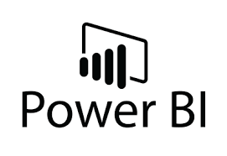
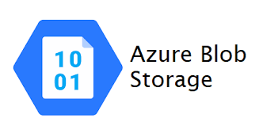
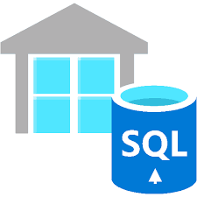
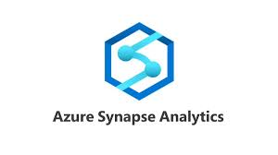
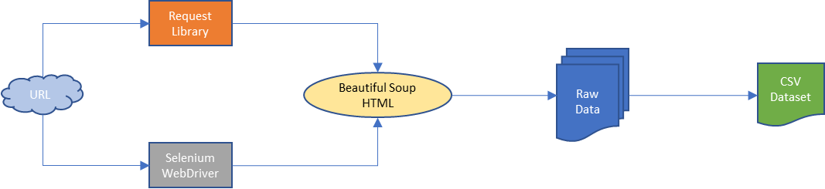

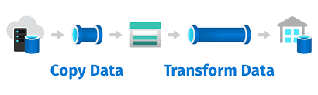

Web scraping program is written using Jupyter Notebook
Dataset is stored in Azure Blob Storage as CSV
Data is pulled from the SQL Pool in Azure Synapse and integrated with Power BI
Dataset is ingested in Azure Synapse Analytics, transformed and sinked into an SQL Pool
Different dashboards are built in Power BI for analysis
Data scraped from:
https://www.wine-searcher.com/critics-8-cellartracker?page=1
https://www.winemag.com/ratings/?s=&drink_type=wine&sort_by=pub_date_web&sort_dir=desc

Slide 2
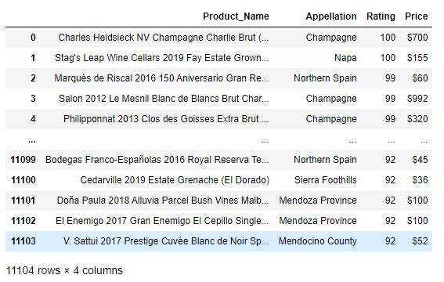
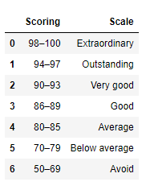
Overview on the raw data scraped:
The above dataset is scraped from 1850 pages

